Slide 1
The Digital Downconverter
Colin Wessels

Slide 2
Description
Used to lower the frequency of a high-frequency signal
Lossless process
Components
Local oscillator (LO)
Mixer
Low-pass filter (LPF)
Decimator / Downsampler

Slide 3
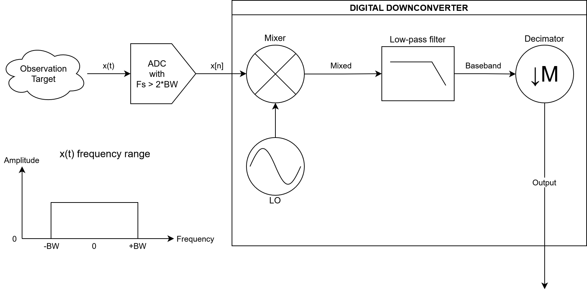
The Digital Downconverter

Slide 4
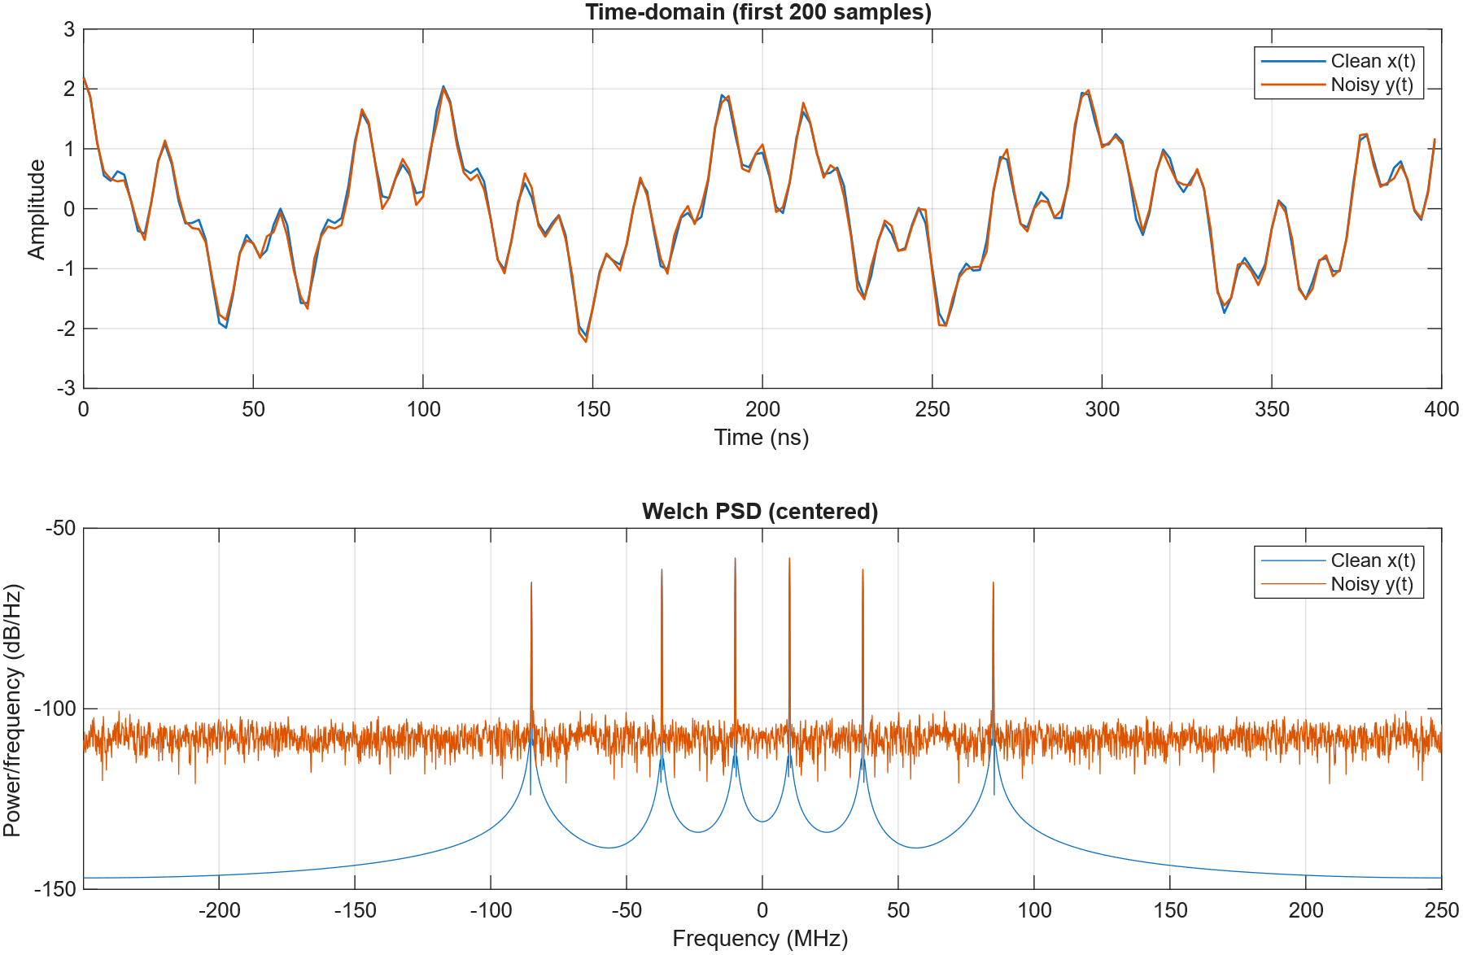
Incoming Frequencies
Tones at 10, 37, 85 MHz with additive white gaussian noise on y(t)
BW = 85 MHz, F_{s} = 500 MHz
Real signal: complex symmetry
-85 MHz -37 MHz -10 MHz +10 MHz +35 MHz +85 MHz

Slide 5
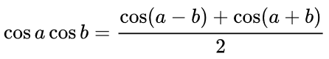
Mixing Stage
Mixing is multiplication of x[n] and the LO of a constant frequency
LO frequency is chosen to be 10 MHz
Multiplication of two periodic signals follows this trigonometric identity:
The goal of downconversion is to frequency shift the signal of interest near 0 Hz.
This is why the LO frequency is equal to the frequency of the signal of interest (10 MHz)
Keep the lower frequency cos(a-b) component (difference)
Discard the higher frequency cos(a+b) component (sum)

Slide 6
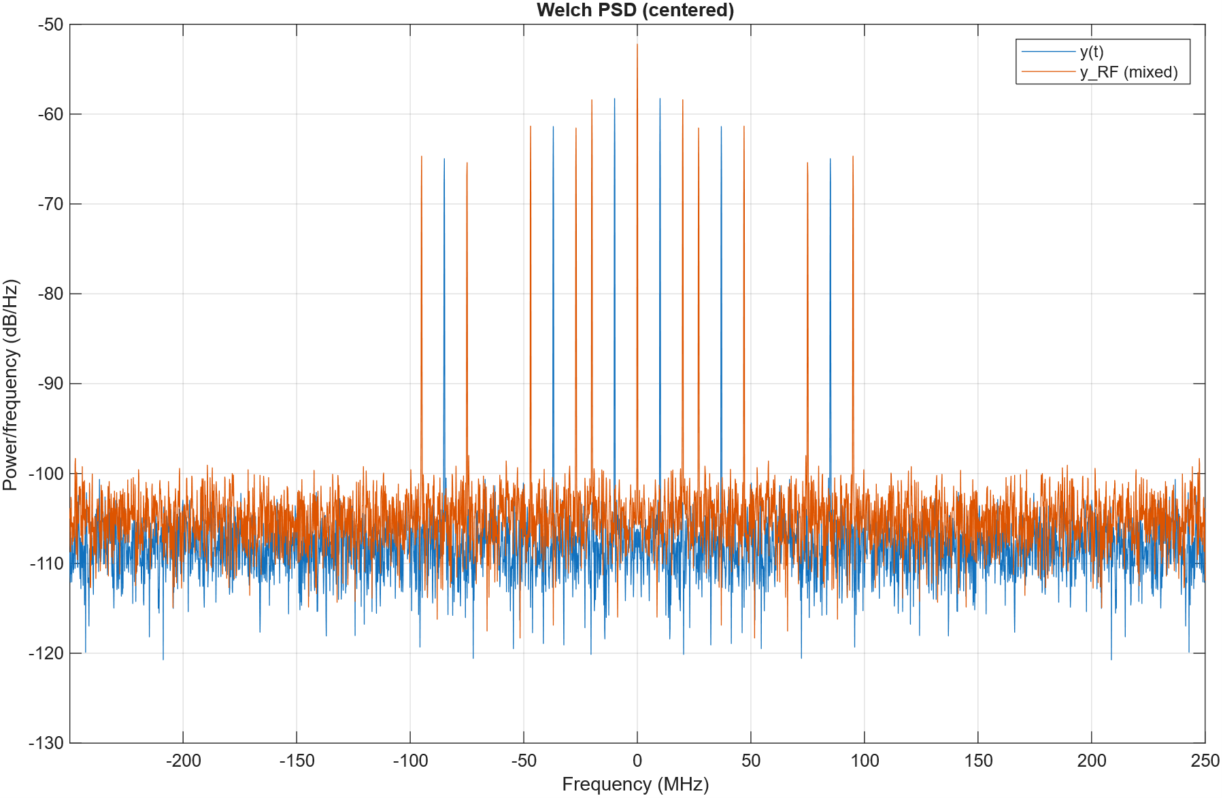
Original frequencies are blue peaks
Mixed signal frequencies are orange peaks
LO frequency = 10 MHz
Orange peaks are +/- 10 MHz apart from blue peaks
At DC: the sum image of -10 MHz and the difference image of +10 MHz combine, essentially doubling the amplitude
-10+10 AND 10-10 ->
-85-10 -85+10
difference sum
85-10 85+10

Slide 7
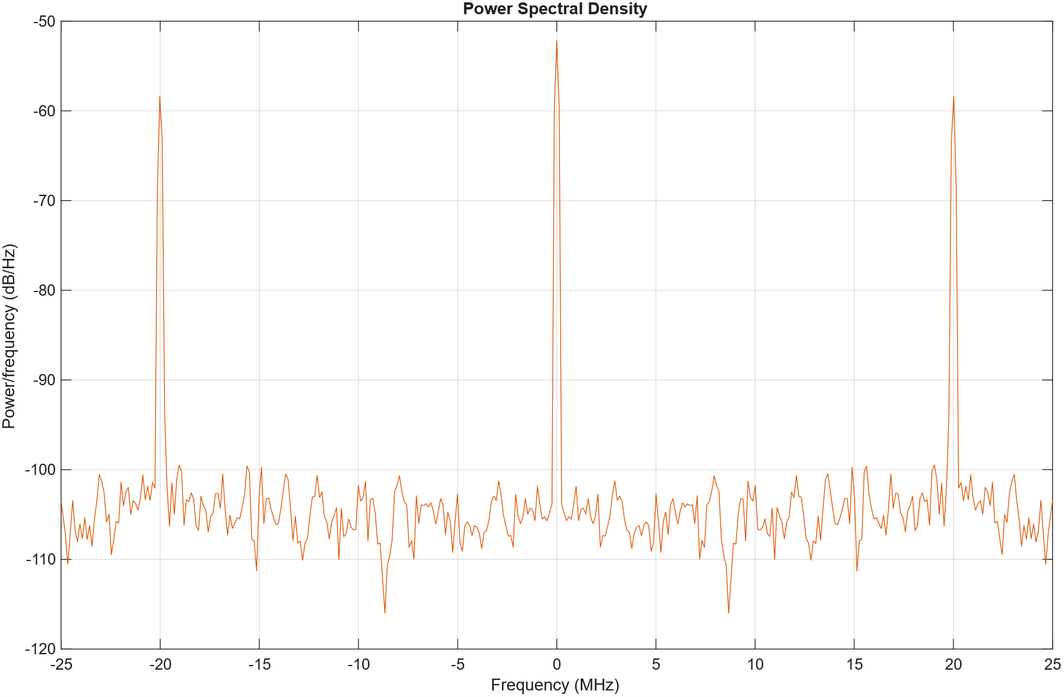
Low-Pass Filtering
Mixing shifted the signal of interested to be centered at DC (0 Hz)
An ideal low pass filter blocks all signals with frequencies greater than the cutoff frequency
Cutoff frequency of 2 MHz will pass the signal centered at DC and block other signals
Passband →
Stopband
Stopband

Slide 8
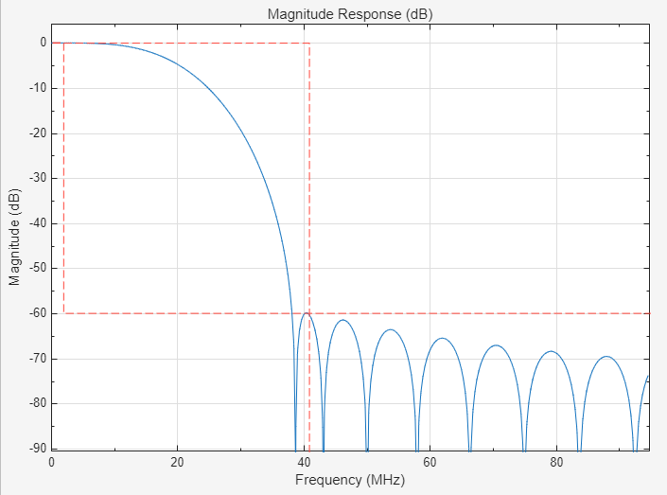
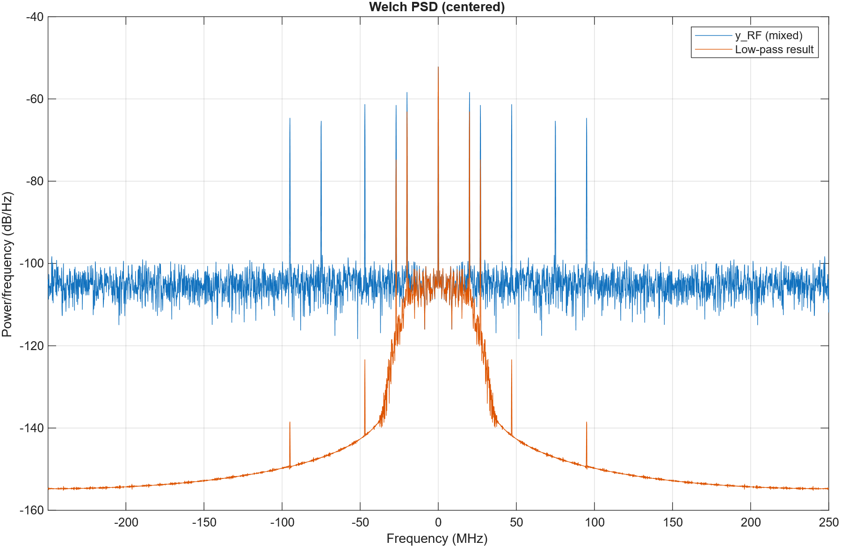
Low-Pass Filtering (cont.)
Non-ideal filter allows +/- 20 and +/- 27 MHZ tones to pass
-60 dB attenuation at 41 MHz

Slide 9
Downsampling
Goal: resample with a lower sample frequency now that our signal bandwidth is much lower
Decimation factor: M = 50, keep every 50th sample
F_{s,new} = F_{s,old}/M = 500 MHz/50 = 10 MHz
No aliasing will occur if Nyquist-Shannon sampling theorem is followed: F_{s} > 2*BW
BW of low-passed signal is ideally 2 MHz, but realistically 27 MHz
Due to non-ideal low-pass filter, we expect to see aliasing after downsampling
For no aliasing: M < F_{s,old}/(2*BW) M < 9.26 for BW of 27 MHz

Slide 10
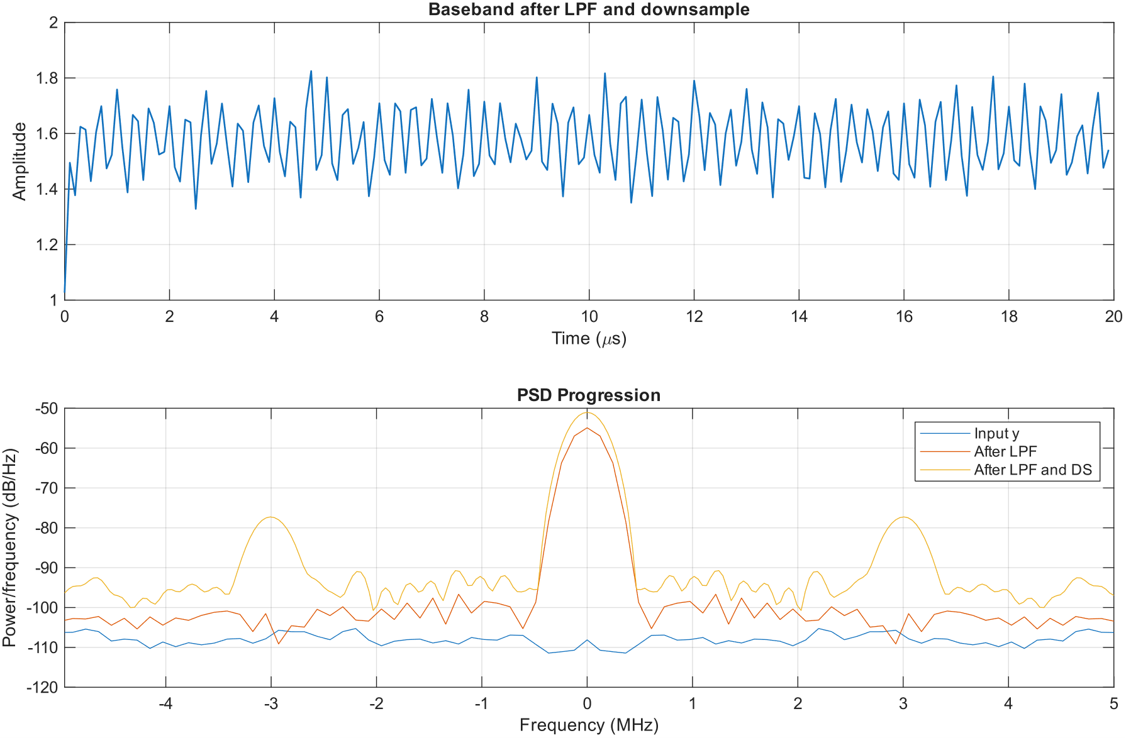
Downsampling (cont.)
Time-series plot is lower frequency (x axis unit change)
Downsampled result shows signals at +/- 3 MHz
This is an alias of the +/- 27 MHz signal, shifted by the new sample frequency of 10 MHz
27 MHz - 3*(10 MHz) = -3 MHz
Downsampled signal is slightly stronger at DC
This is an alias of the +/- 20 MHz signal
20 MHz – 2*(10 MHz) = 0 MHz
Aliasing of other signals is interfering with signal of interest

Slide 11
Lessons learned
Mixing two signals is equivalent to multiplication
Mixing produces two images, the sum and difference
The local oscillator frequency can be chosen to move a signal of interest to DC
The LO frequency equals the signal of interest frequency
In this case, a sum and difference image of both conjugates of the signal of interest will combine at DC = 0 Hz
A low-pass filter is used to block all signals except the signal of interest near DC
Downsampling reduces the sample frequency of the signal without aliasing, provided the LPF reduces the bandwidth enough
Reducing the sample frequency gets rid of unnecessary samples, making it practical to store and analyze the signal
The result is 1 narrow-bandwidth signal chosen out of a wide range of frequencies

